Slide 1








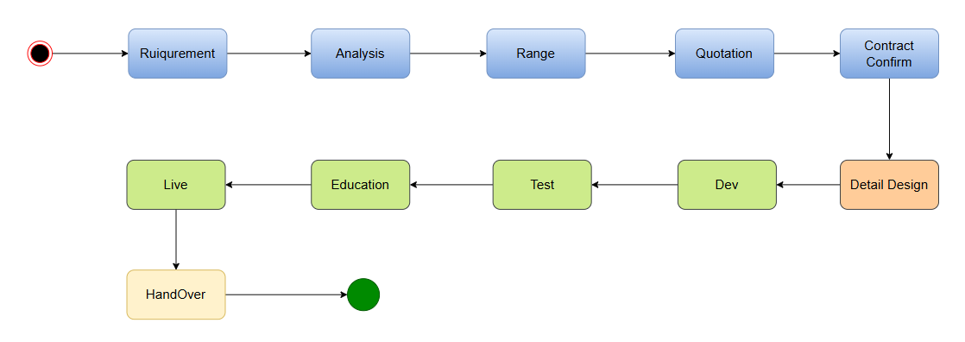
Customer
Contract
Development
Test
Education
Live
Handover
Output
Contract

